Slide 1
Towards a sustainable pay-as-you-go pension system: the Italian case study
a.a. 2021/2022
Corso di Introduzione Alla Fisica Dei Sistemi Complessi
Prof. Armando Bazzani
Tommaso Antonelli, Paola Persico, Chiara Zelco

Slide 2
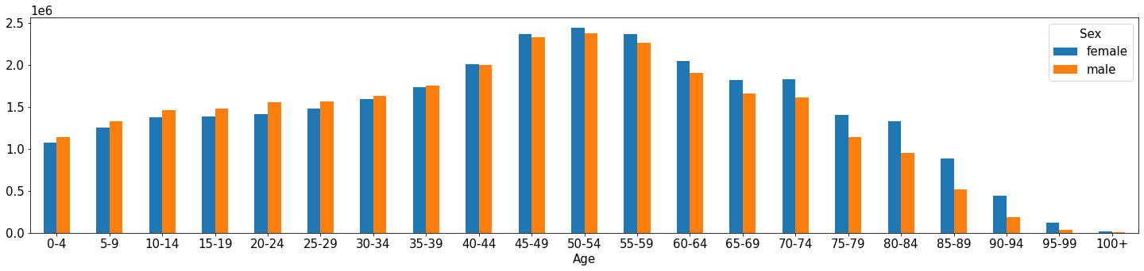
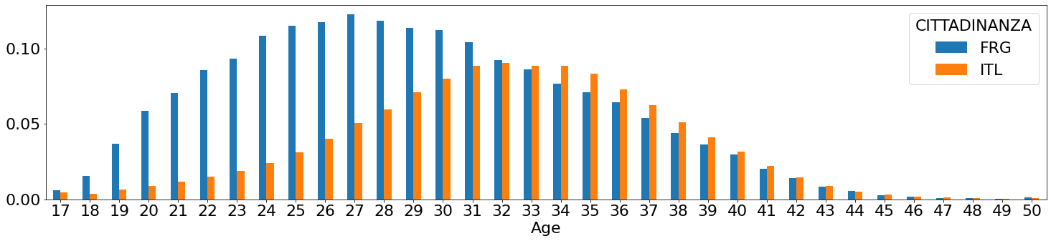
Initial conditions: population and birth rates
Initial population by age and gender.
Initial birth rates for Italian (ITL) and foreign (FRG) population.

Slide 3
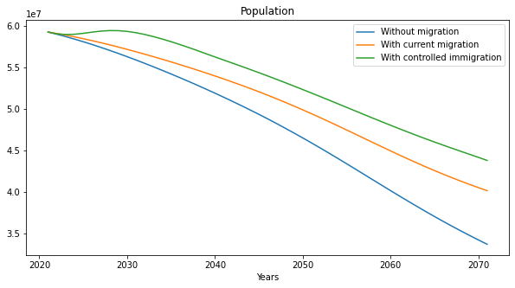
Population evolution
Population evolution in the considered migration scenarios: no migration, current migration and controlled immigration.

Slide 4
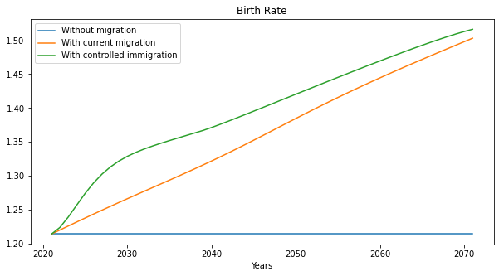
Birth rate evolution
Birth rate evolution in the considered migration scenarios: no migration, current migration and controlled immigration.

Slide 5
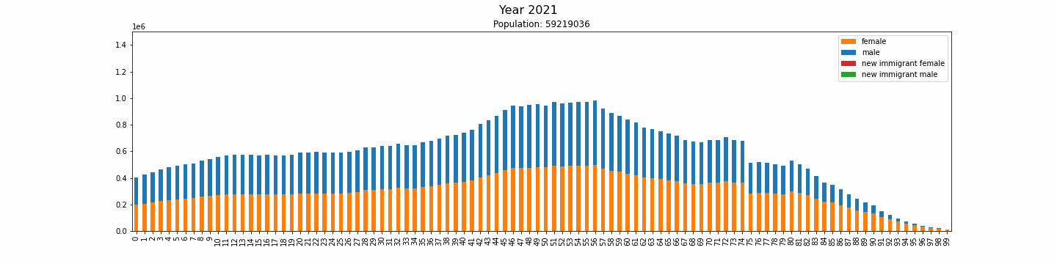
Population evolution
I scenario: without migration
Population evolution in the first scenario: no migration flows.

Slide 6
Population evolution
II scenario: current immigration
Population evolution in the second scenario: migration flow computed with values registered in 2021.

Slide 7
Population evolution
III scenario: controlled immigration
Population evolution in the third scenario: controlled immigration flow.

Slide 8
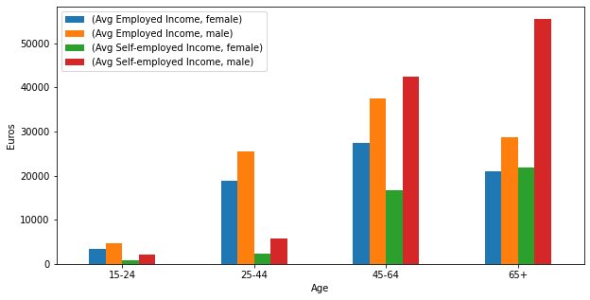
Average income
Average population income. Population is divided by working category (employed or self-employed), age group and gender.

Slide 9
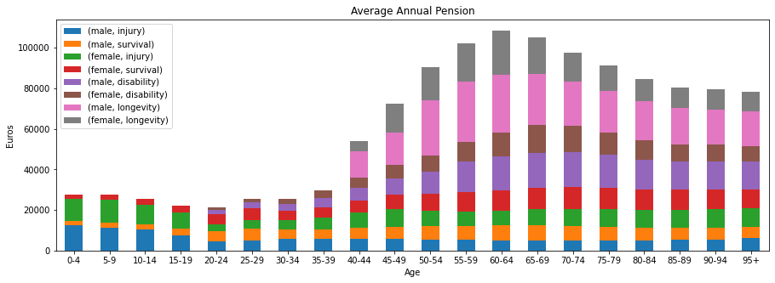
Average annual pension: by categories, age and sex.
Average annual pensions. Considered categories: surival, injury, disability and longevity. The population is divided by gender and age group.

Slide 10
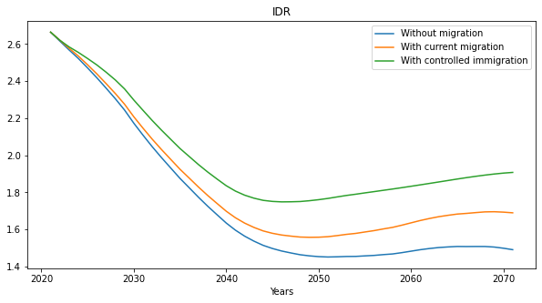
Inverse dependency ratio evolution
Inverse dependency ratio evolution in the considered migration scenarios: no migration, current migration and controlled immigration.

Slide 11
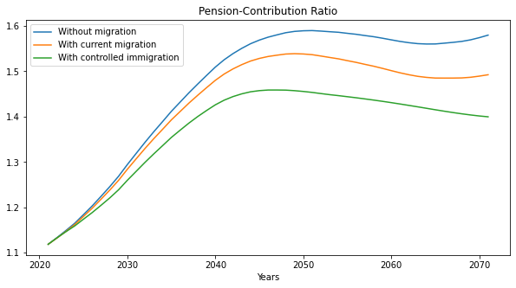
Pension-Contribution Ratio: no economic measures applied
Pension – Contribution ratio evolution in the considered migration scenarios. No economic measures have been applied.

Slide 12
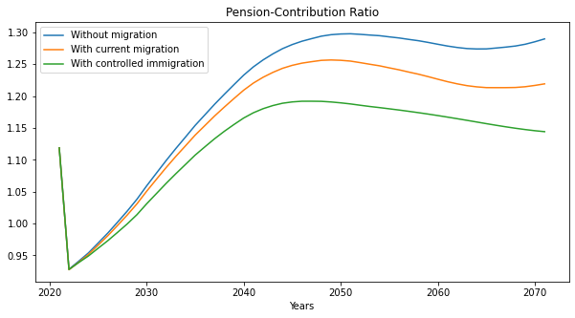
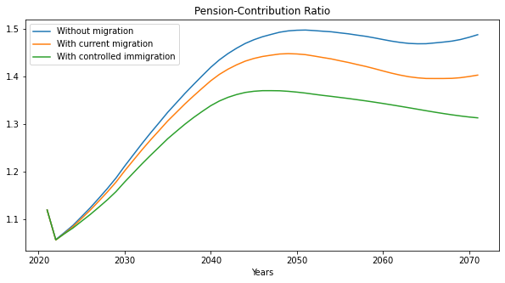
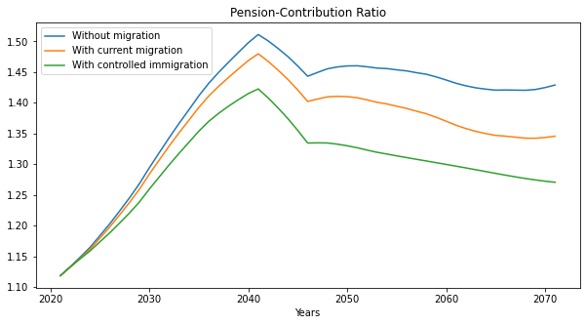

Pension-Contribution Ratio: separate application of economic measures
Contribution rates increase.
Employed:
33% → 40%
Self employed: 25 → 30%
Retired:
24 → 30%
Ocupation rate increase (by 10%)
Pension age increase (gradual application)
Pension average amount decrease (by 10%)

Slide 13
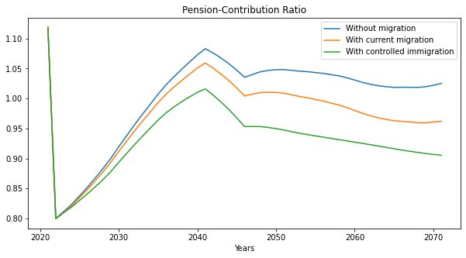
Pension-Contribution Ratio: application of all economic measures
Pension – Contribution ratio evolution in the considered migration scenarios. All economic measures applied.

